Slide 1
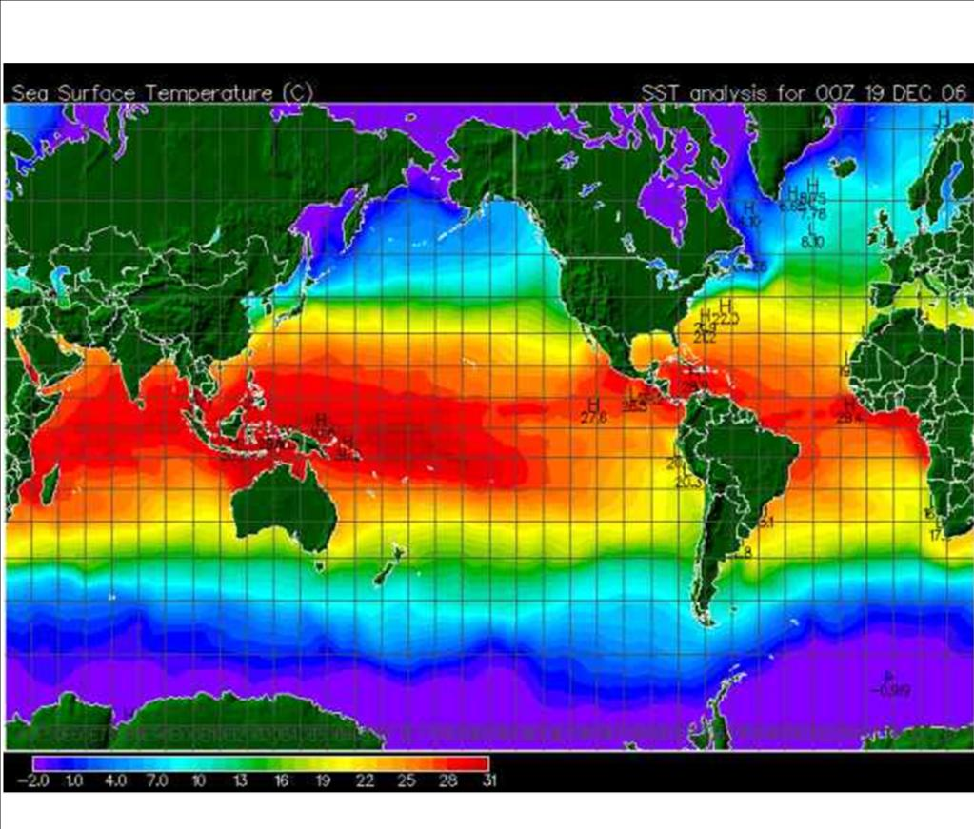
Climate and Seasons

Slide 2
Latitude Maine

Slide 3
Elevation

Slide 4
Elevation

Slide 6
Hawaiian Islands

Slide 7
Windward side of Hawaii

Slide 8
Leeward Hawaii

Slide 9
Oregon Coast

Slide 10
Oregon Coast Clearing.. A bit..

Slide 12
Climate Factors
Identify five factors
that affect climate
and explain
how each
affects climate.

Slide 13
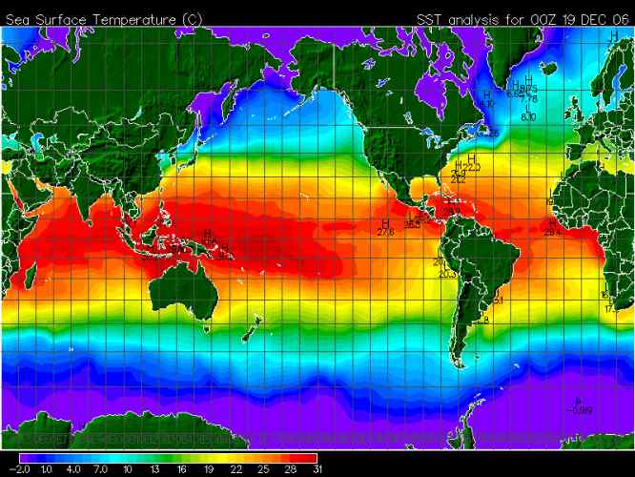
1)
Latitude

Slide 14
As latitude ________, the average
annual temperature _________.
increases
decreases
Temperature
0° Latitude 90°

Slide 15
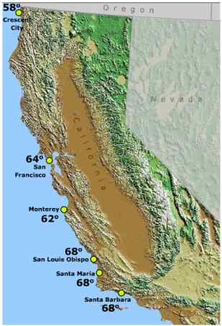
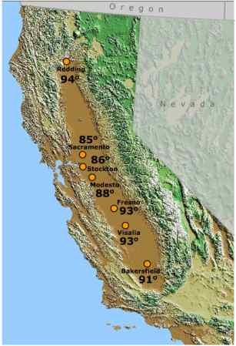
2)
Closeness to Large Bodies of Water

Slide 16
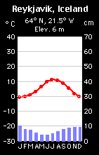
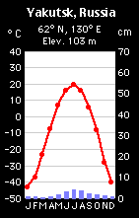
Coastal
Inland

Slide 17
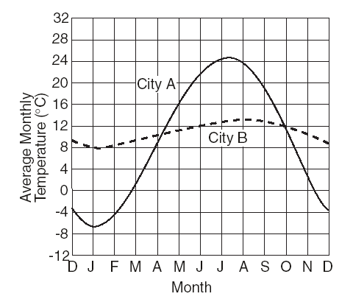
How does closeness to a large
body of water affect climate?
Water __________ the temperature.
_______ summers. _______ winters.
moderates
Cooler
Warmer
Cities A & B are located at the same latitude.
City B is closer to a large body of water b/c temp. line has a smaller temp. range. (less change)

Slide 18
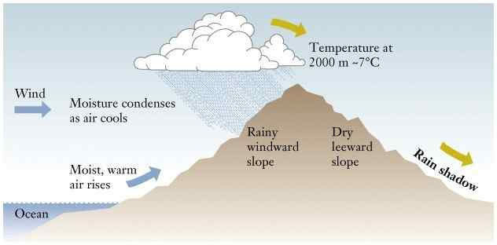
Orographic Effect
3)

Slide 19
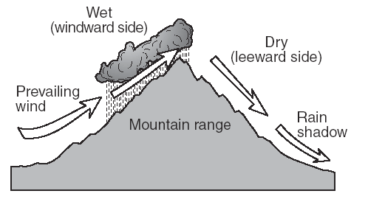
How does the
Orographic Effect
affect climate?
Windward Side: ___________
Leeward Side: _____________
cool, moist
warm, dry

Slide 20
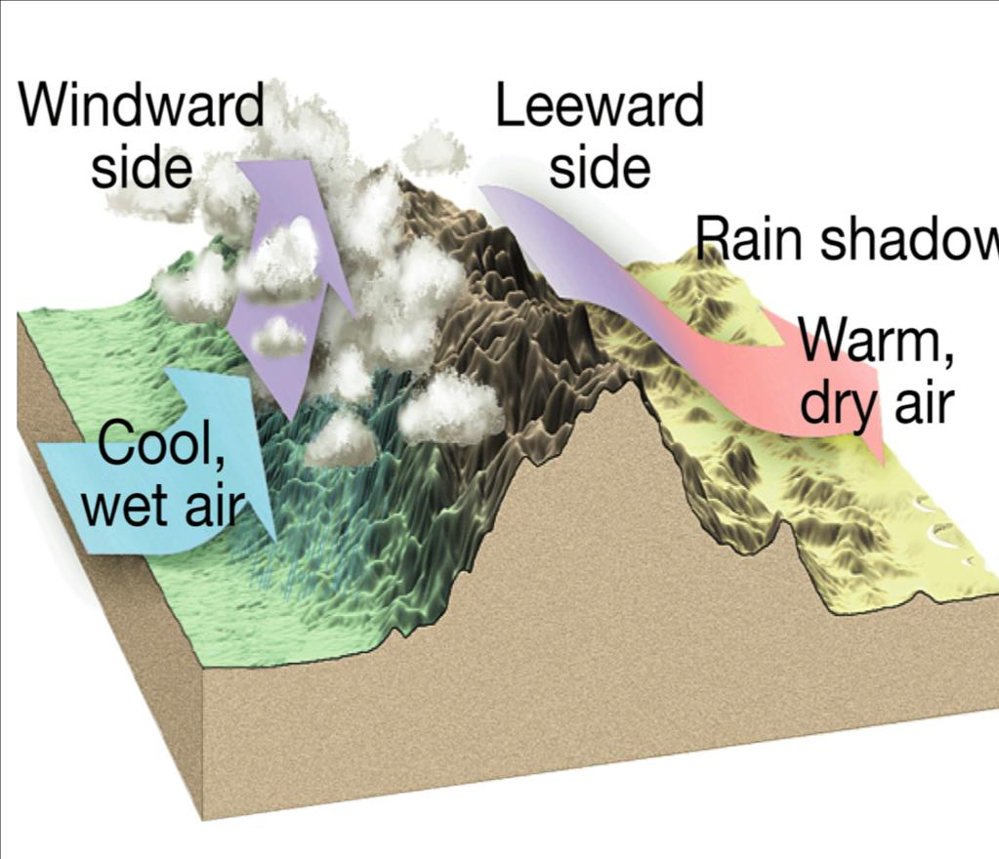

Slide 21
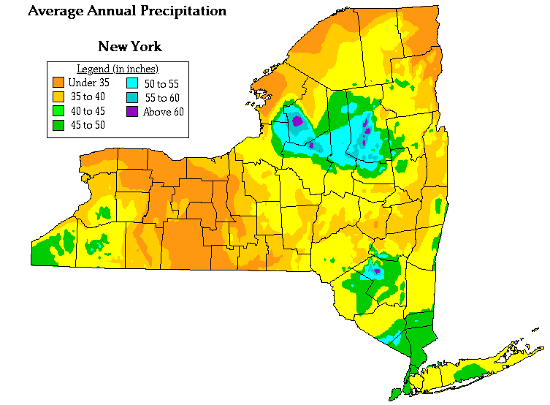
The leeward sides of the Adirondacks & Catskills receive much less precipitation
The windward sides of the Adirondacks & Catskills receive a great deal more precipitation

Slide 22
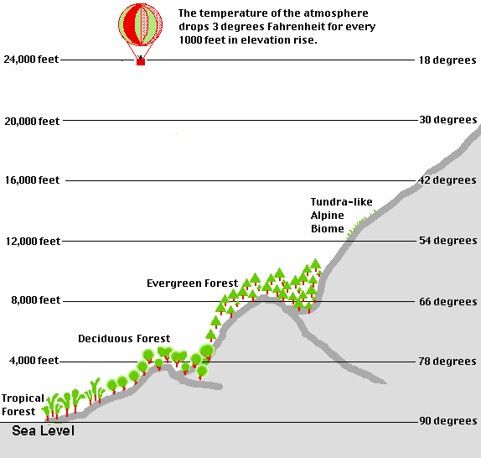
4))
Elevation

Slide 23
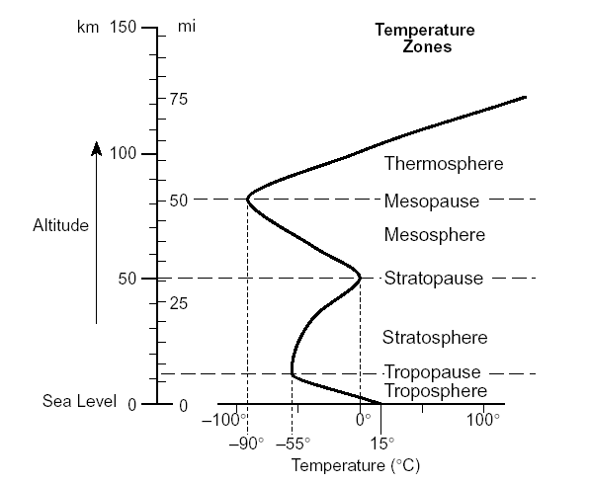
Elevation
Page 14 of the ESRTs
We live in the troposphere. Temperature decreases
with elevation.

Slide 24
How does elevation
affect climate?
As elevation _________, the average
annual temperature __________.
increases
decreases
Temperature
Elevation

Slide 25
5)
Ocean Currents
ESRT pg 4

Slide 26
How do ocean currents
affect climate?
Warm Currents: warmer climate
Cold Currents: cooler climate

Slide 27
Planetary Winds

Slide 28
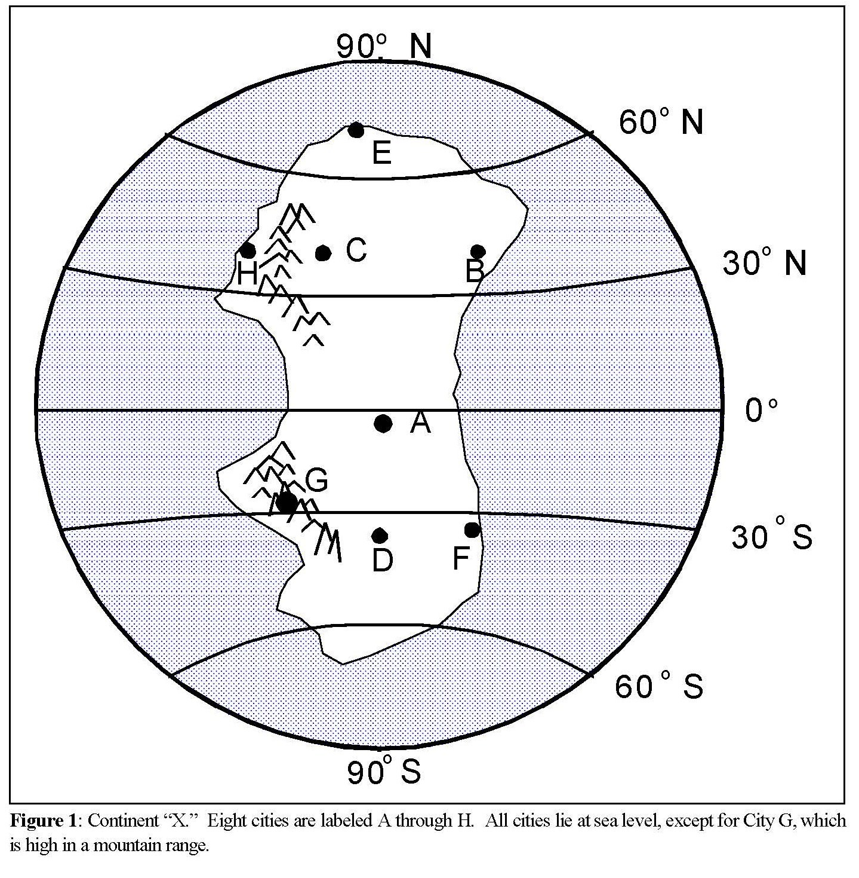
Factors that affect the Climate of an Imaginary Continent.

Slide 33
Sun's Energy & Climate
According to the graph below,
what wavelength
of energy does the Earth
receive in the greatest intensity?
visible light

Slide 34
Name the primary gas
which absorbs ultraviolet (UV)
from the sun.
ozone

Slide 35
Sun's Energy & Climate
Why is the ozone
layer important?
It protects the Earth from UV which damages crops and
causes cancer in humans.

Slide 36
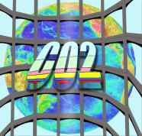
Name the three primary gases
which absorb infrared (IR) energy
methane
water vapor

Slide 37
Sun's Energy & Climate
Why is it warmer on a
cloudy night than
on a clear night?
Clouds and H₂O vapor absorb IR energy radiated by the Earth. On a clear night, the IR energy escapes back into space.

Slide 38
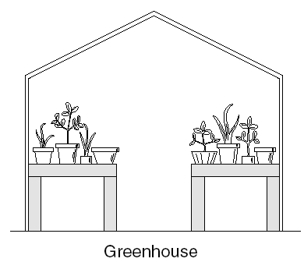
Explain the greenhouse effect. Include a diagram
which shows the change in wavelength.

Slide 39
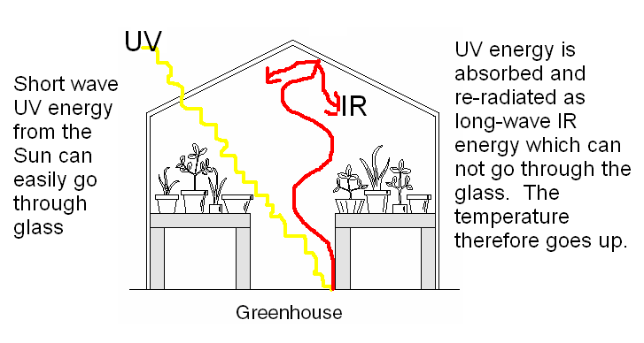
Explain the greenhouse effect. Include a diagram
which shows the change in wavelength.
VISIBLE
Visible Energy is
Visible Energy

Slide 40
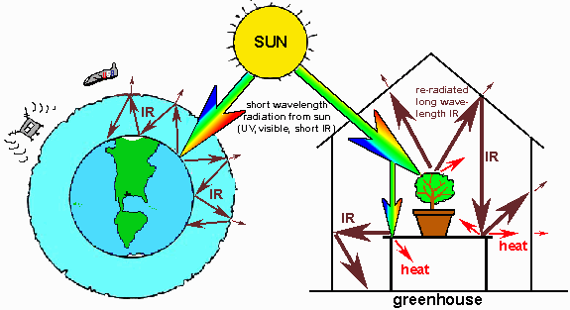
Just like a greenhouse, the gases in
the atmosphere ---especially CO₂ ---
absorb re-radiated infrared energy.

