Slide 2
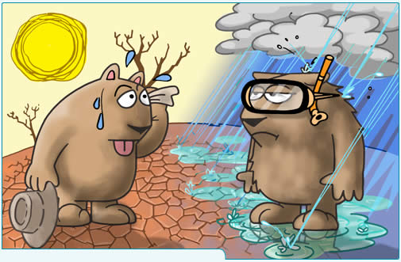
Climate Change

Slide 3
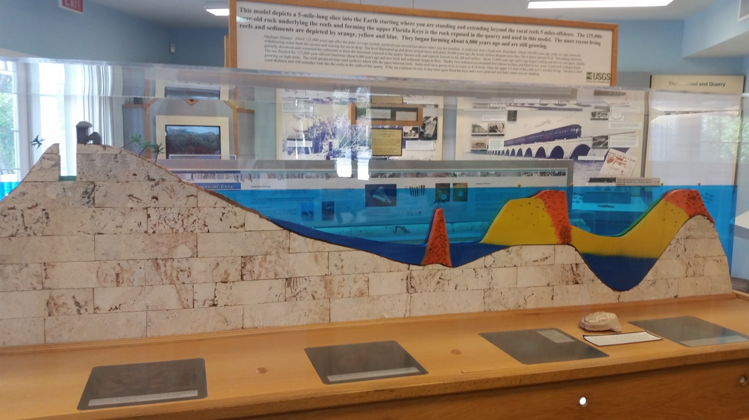
Climate has changed throughout Earth’s History… The Florida Keys used to be like the Great Barrier Reef.

Slide 4
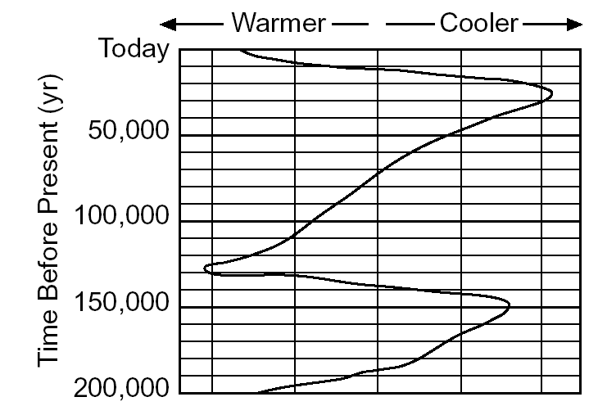
Ice Ages

Slide 5
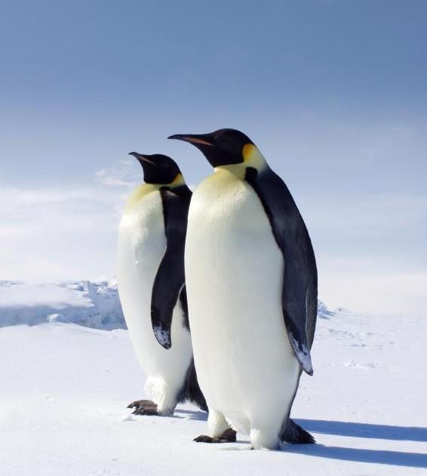
Ice Ages
Ice Ages are cyclic.
The last one occurred
~12,000 years ago
The exact cause of
what triggers an ice age
is not known

Slide 6
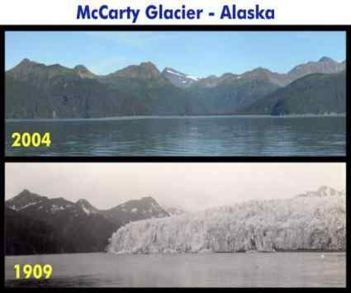
Global Warming

Slide 7
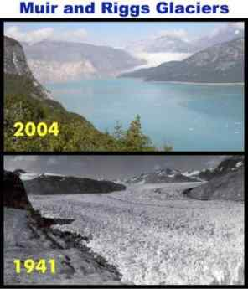

Slide 8
Global Warming
Average global temperatures
are increasing.
Glaciers are melting.
Ocean levels are rising.
Warming is natural.
Humans are speeding up the process
through increased levels of
carbon dioxide (CO₂)

Slide 9
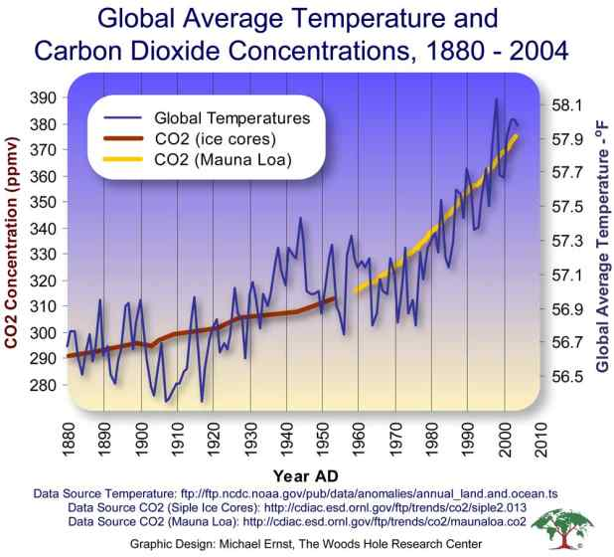

Slide 10
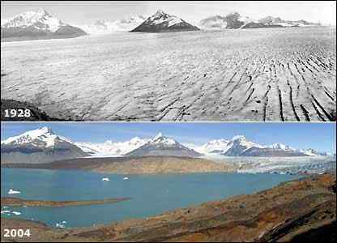

Slide 11
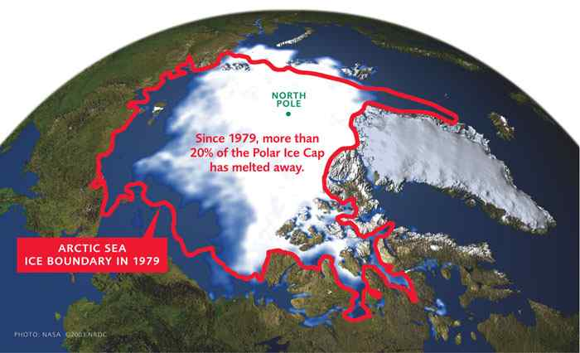

Slide 12
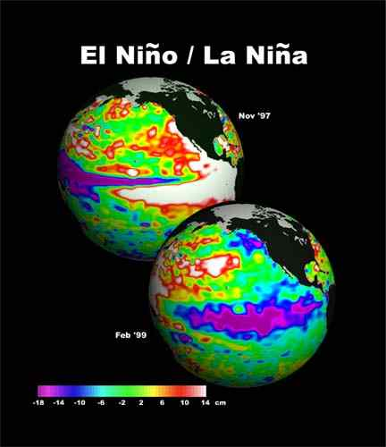

Slide 13
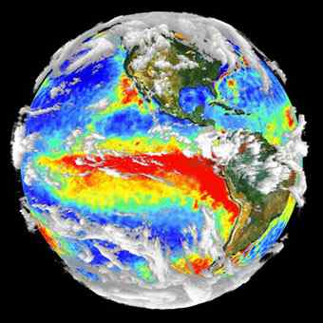
El nino Explained (:30)
El Niño
A warming of the
Pacific Ocean.
Winters:
West = Stormy
South = Cold, wet
Northeast = warmer

Slide 14
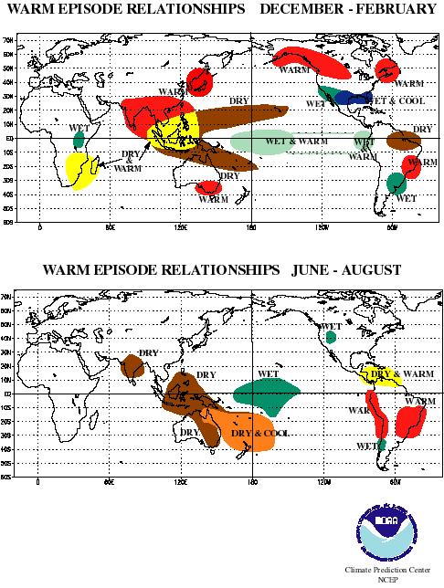

Slide 15
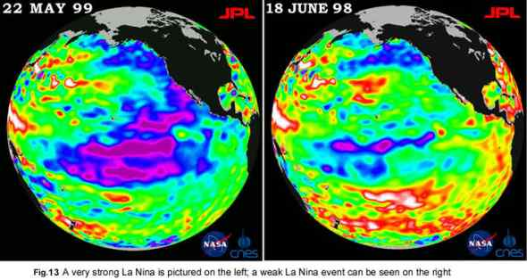
La Niña
A cooling of the Pacific Ocean.
Dry in southeast. Cool, wet in northwest.

Slide 16
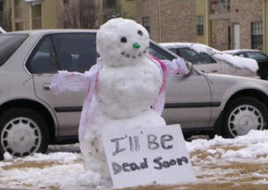
Seasons
Overview of Seasons (10:30)
Seasons overview
Summer
Winter
Fall
Spring

Slide 17
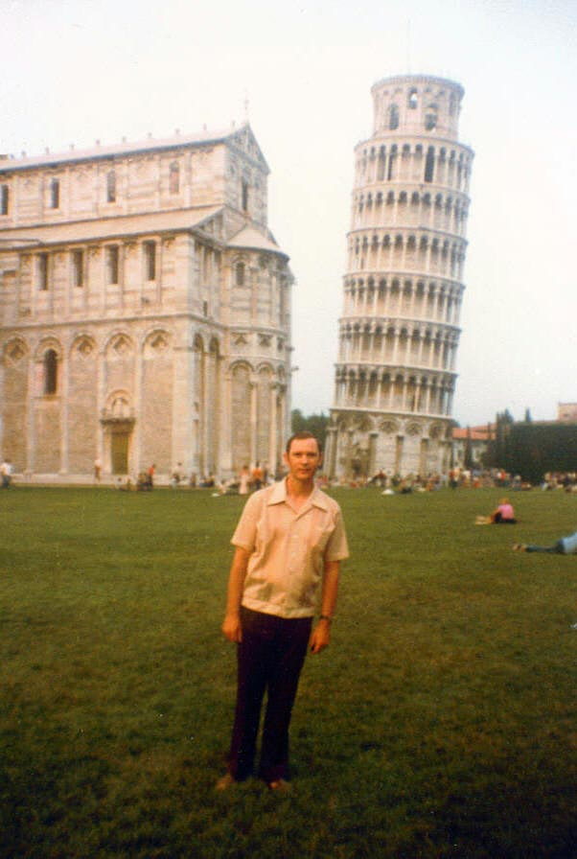
Reasons for the Seasons
- 23.5 °
- Causes different latitudes to have different amounts of day light.

Slide 18
Insolation:
- Greater angle and duration of insolation = warmer temperatures.
- Greatest angle of incidence is 90 °

Slide 19
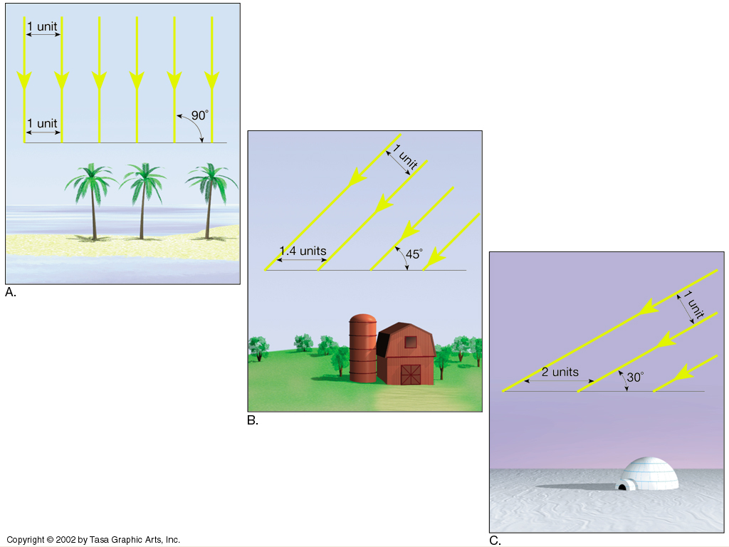

Slide 20
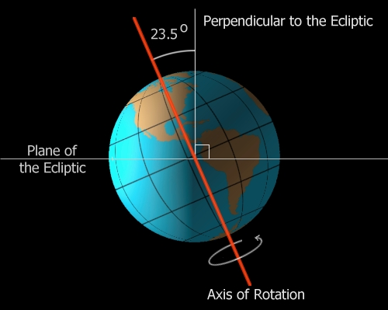
For the northern hemisphere…
Summer: N. Hemisphere is tilted toward to sun = greatest amount of insolation. (June 21st)
Winter: N. Hemisphere tilted away from sun = least amount of insolation. (Dec. 21st)
Summer June 21st

Slide 21
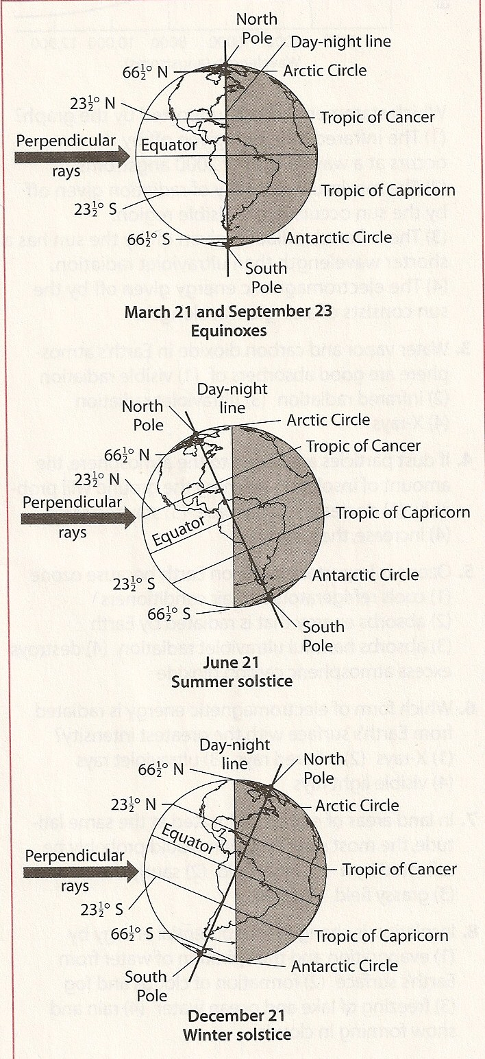
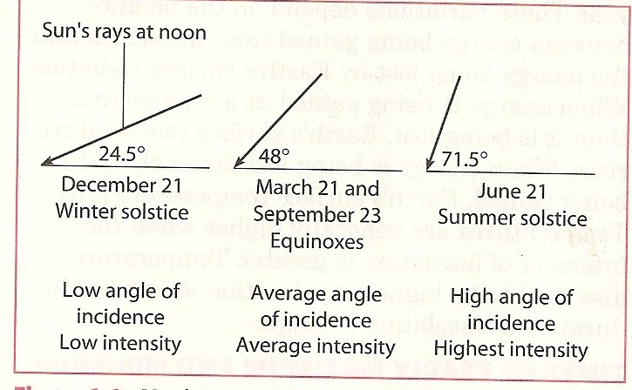

Slide 22
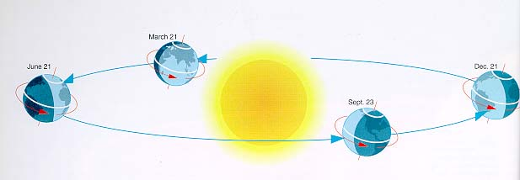
Earth’s orbit around the sun.

Slide 23
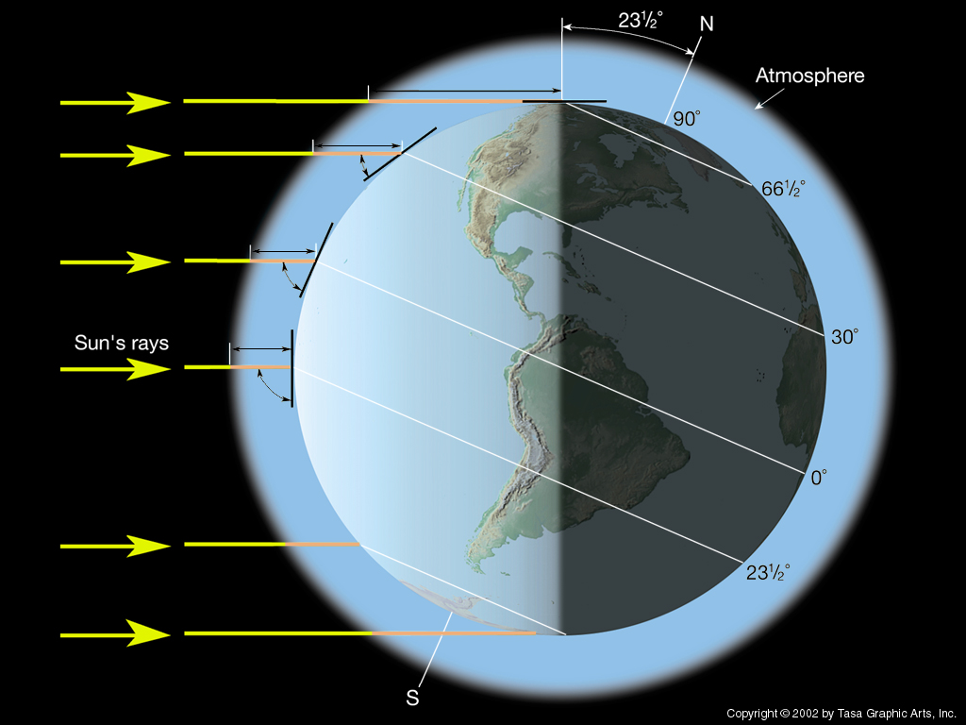
- NO, but Earth’s tilt relative to the sun changes as Earth revolves around the sun.
Winter in N. Hemisphere (Dec 21)

Slide 24
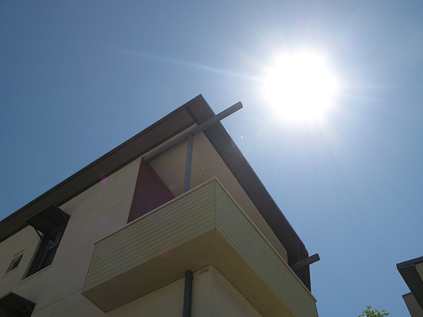
Altitude of the Noon Sun & Path through the Sky
- When the sun reaches its highest point in the sky
Around clock noon but not exactly
*Around Solar noon the Sun is always in the south North of the Tropics in the Northern Hemisphere *

Slide 25
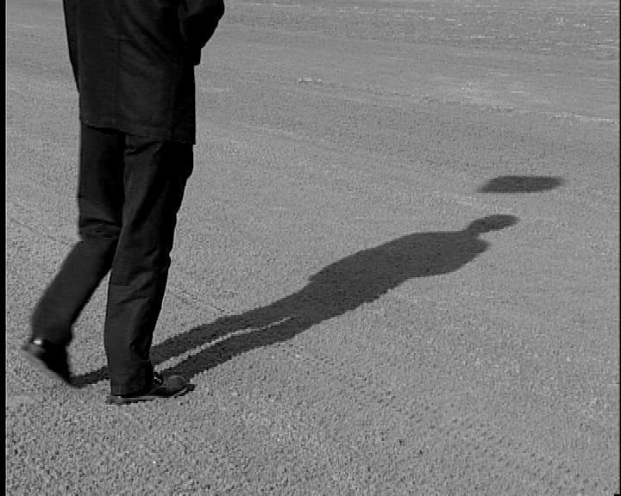
- LONGER when sun is LOWER in the sky.
Direction of shadow =opposite of sun’s direction.

Slide 26
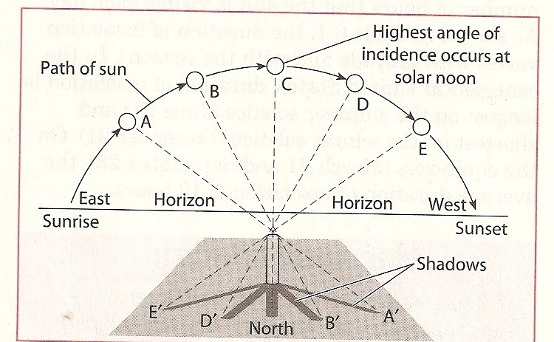
Why does this matter? Solar school house (10:30)

Slide 27
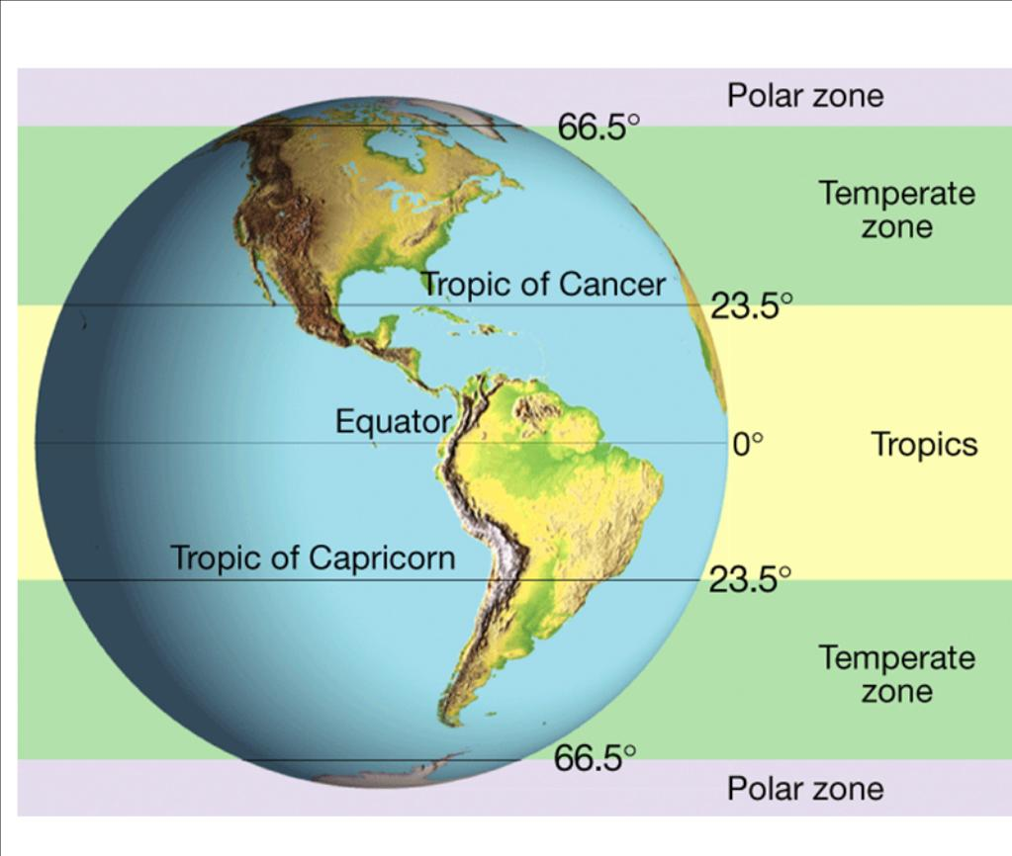
Any location between 23.5 ° N and 23.5 ° S

Slide 28
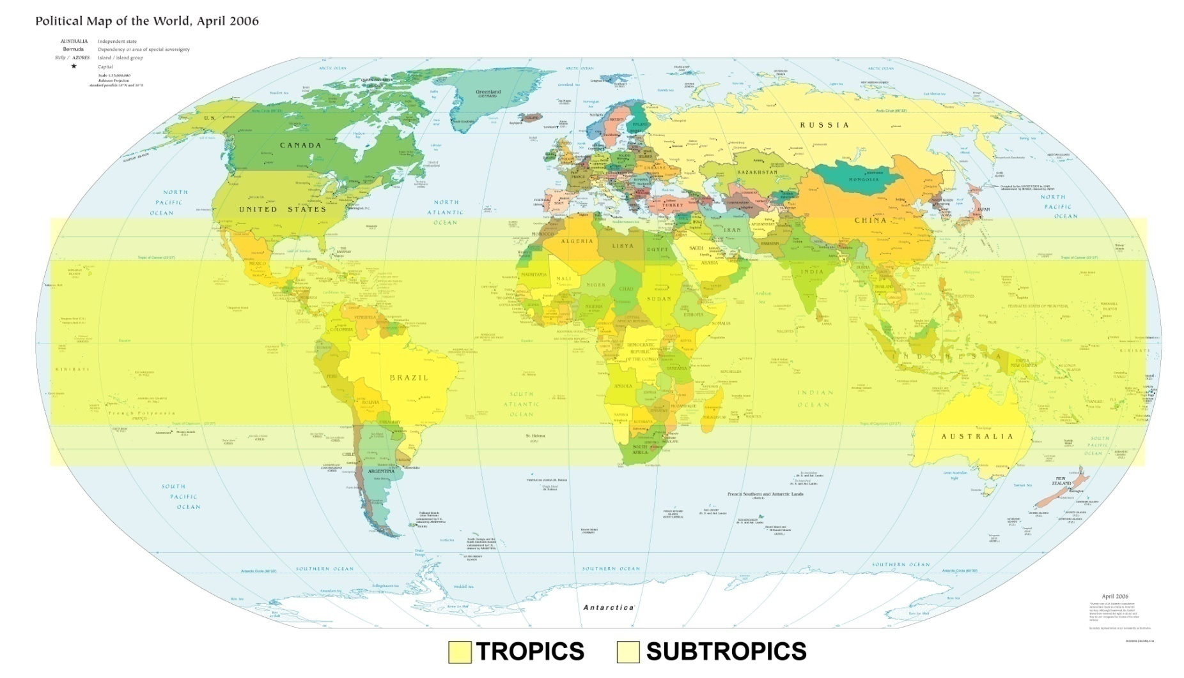
The last place N. or S. of the Equator where the sun is directly overhead (23.5 ° N and S of Equator) (B/C of Earth’s Tilt)

Slide 29
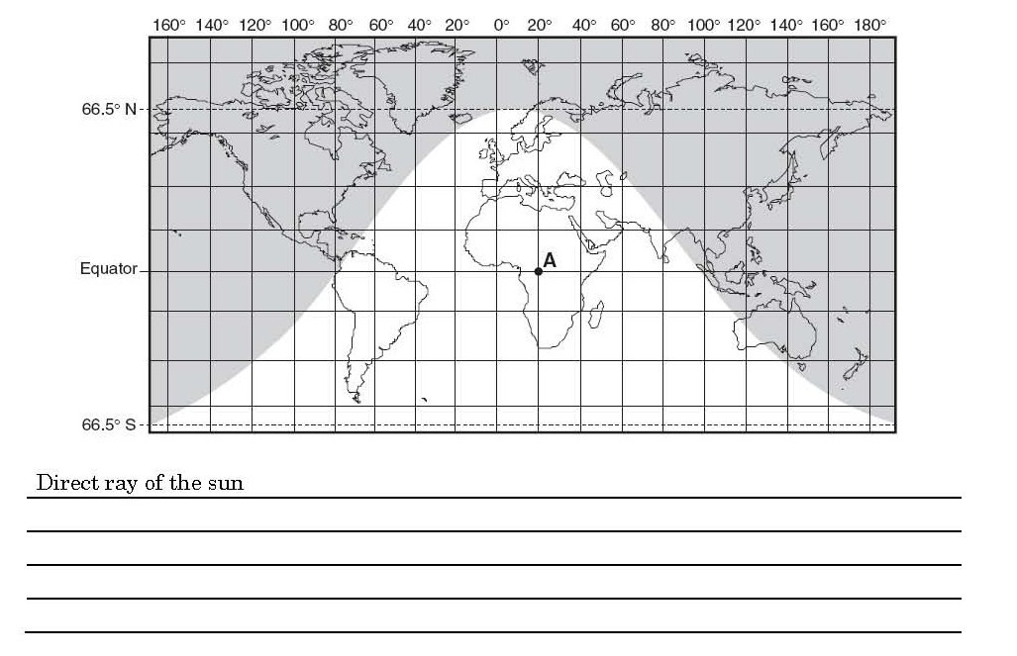
AKA sun’s vertical rays.
- Occurs when sun is directly overhead (at zenith)
- Only occurs from 23.5 N to 23.5 S *****Never occurs in New York State

Slide 30
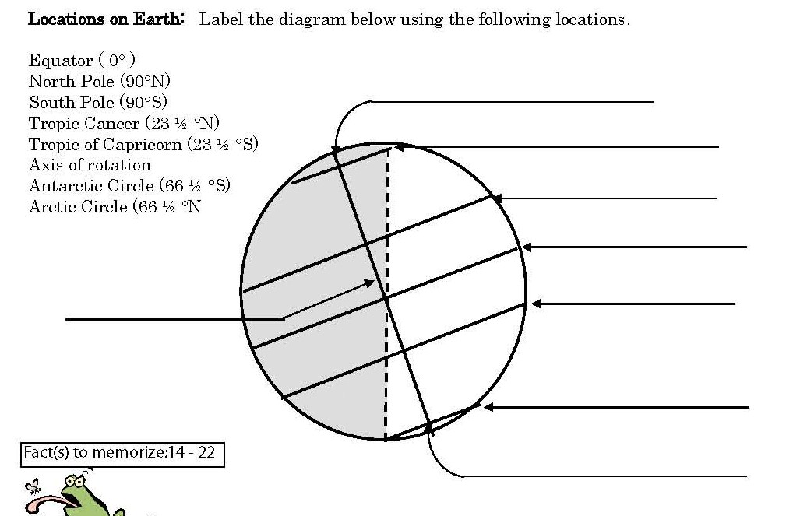
North Pole (90 ° N)
Arctic Circle ( 66.5 ° N)
Tropic of Cancer (23.5 ° N)
Equator (0 °)
Tropic of Capricorn (23.5 ° S)
Axis of rotation
Antarctic Circle 66.5 ° S)
South Pole (90 ° S)

Slide 31
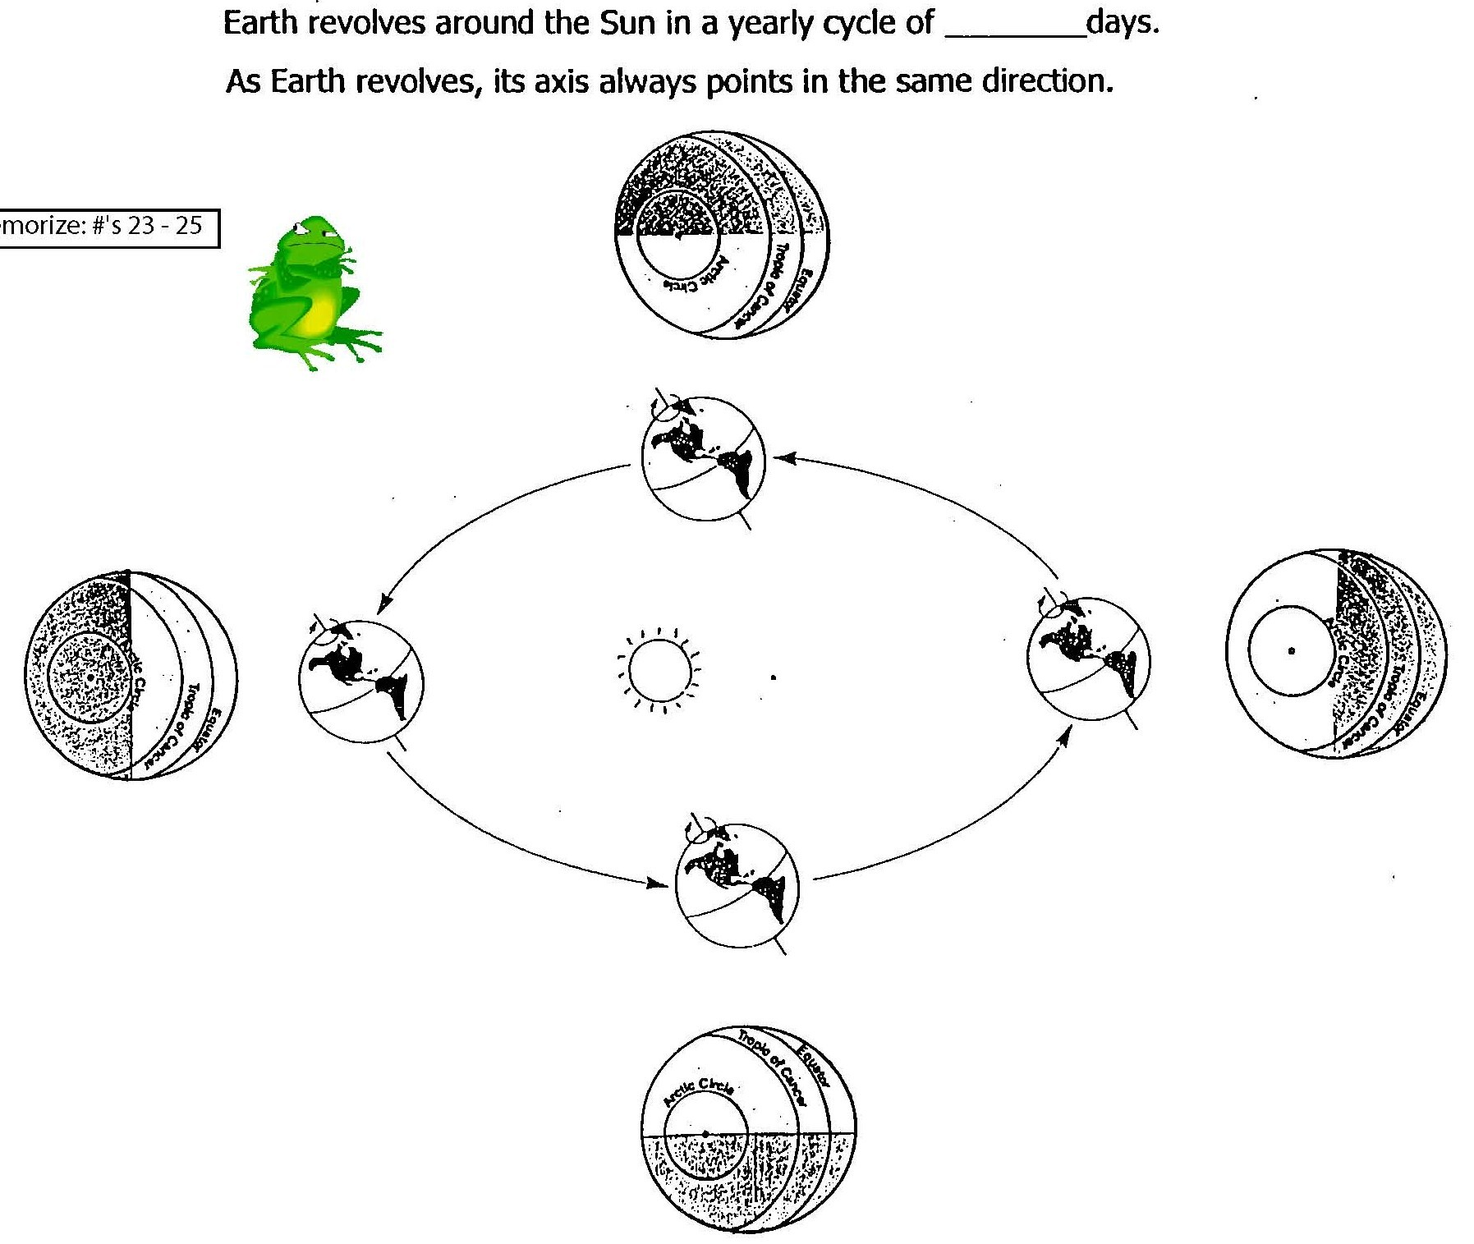
365 1/4

Slide 32
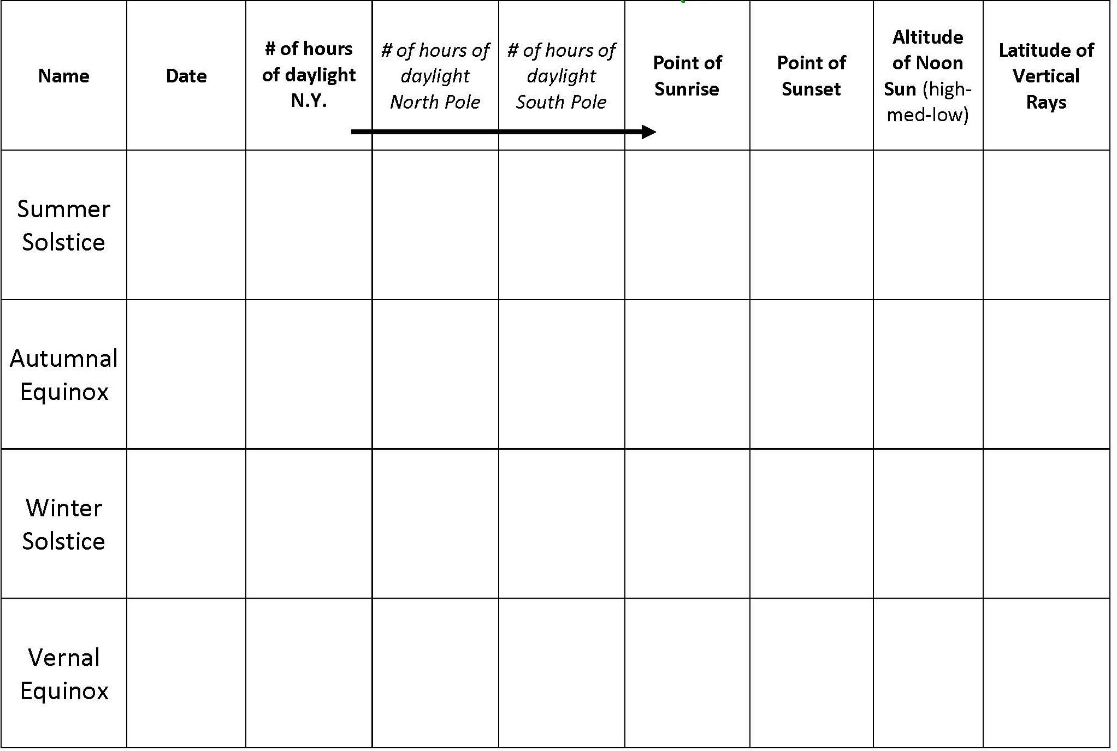
North of
East
June 21
16
24
0

Slide 33
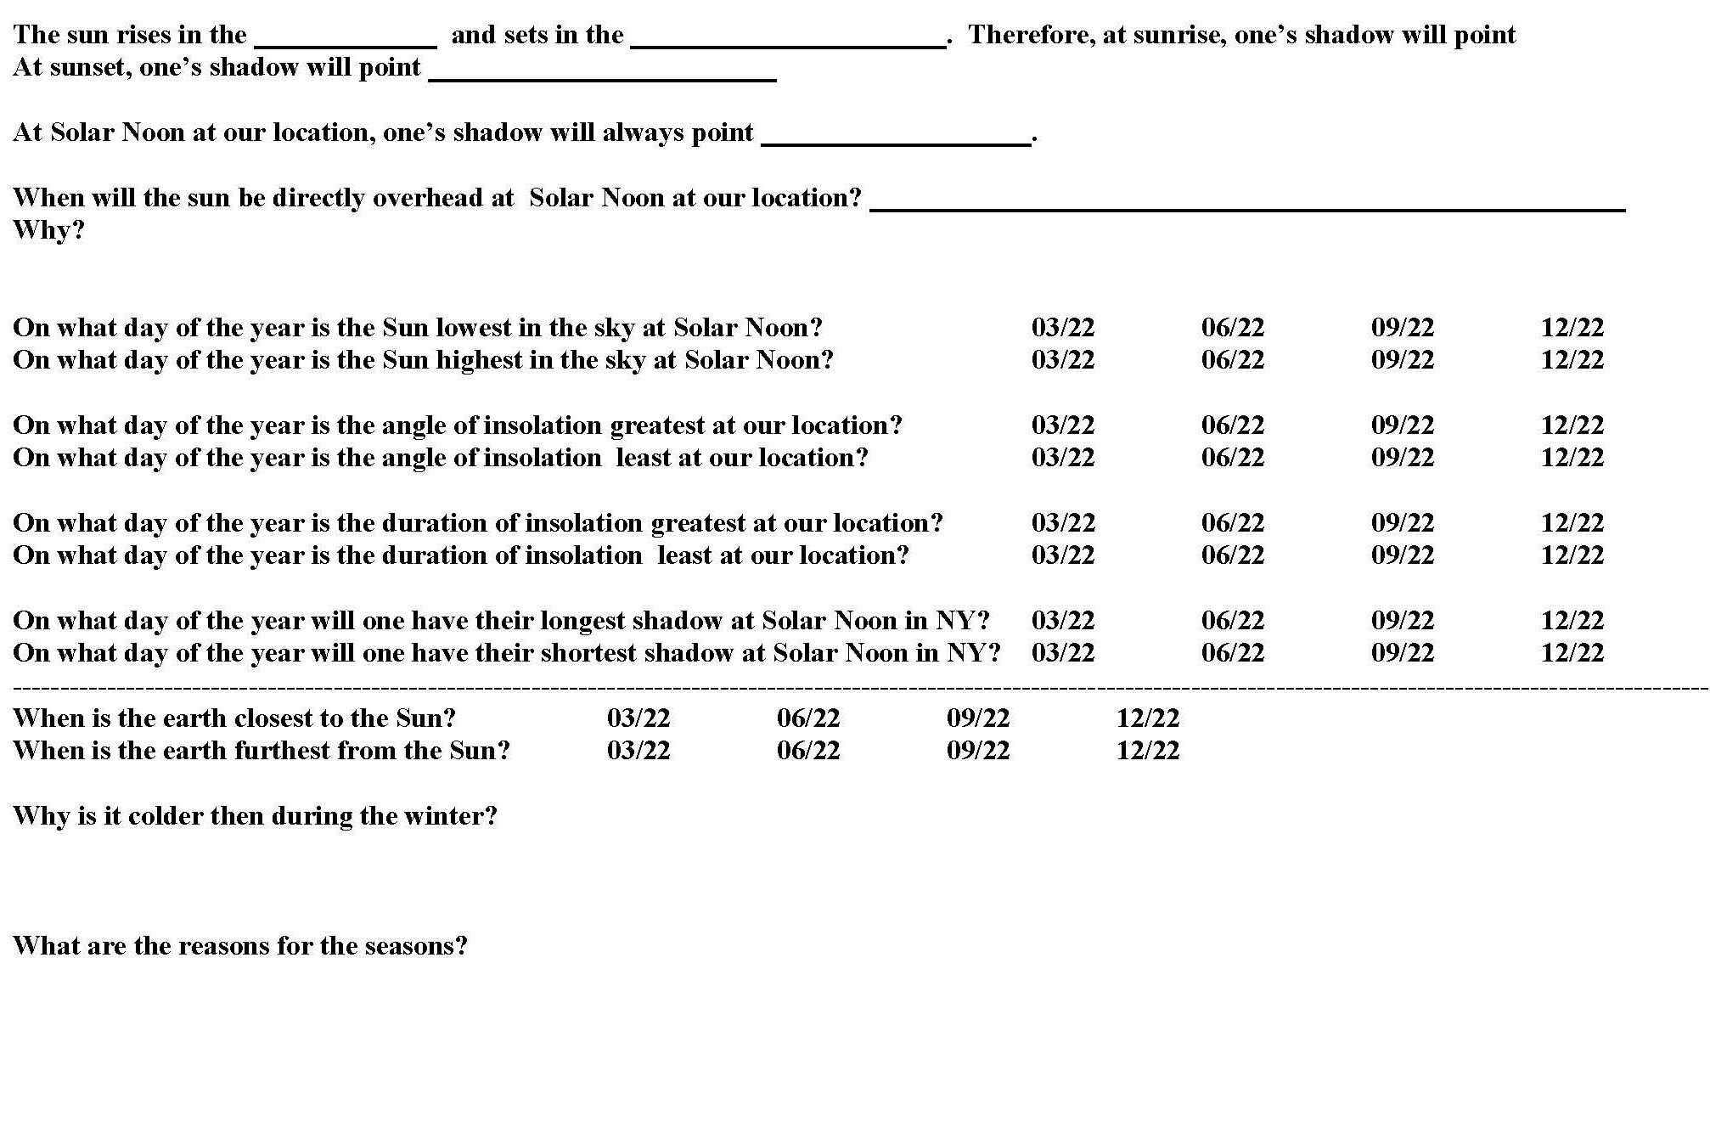

Slide 34
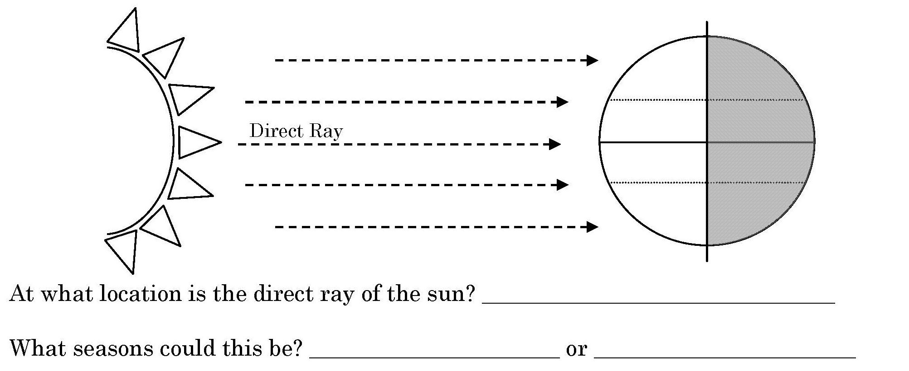
Angle of Insolation/ Angle of Incidence
Equator (0°)
Spring
Fall

Slide 35
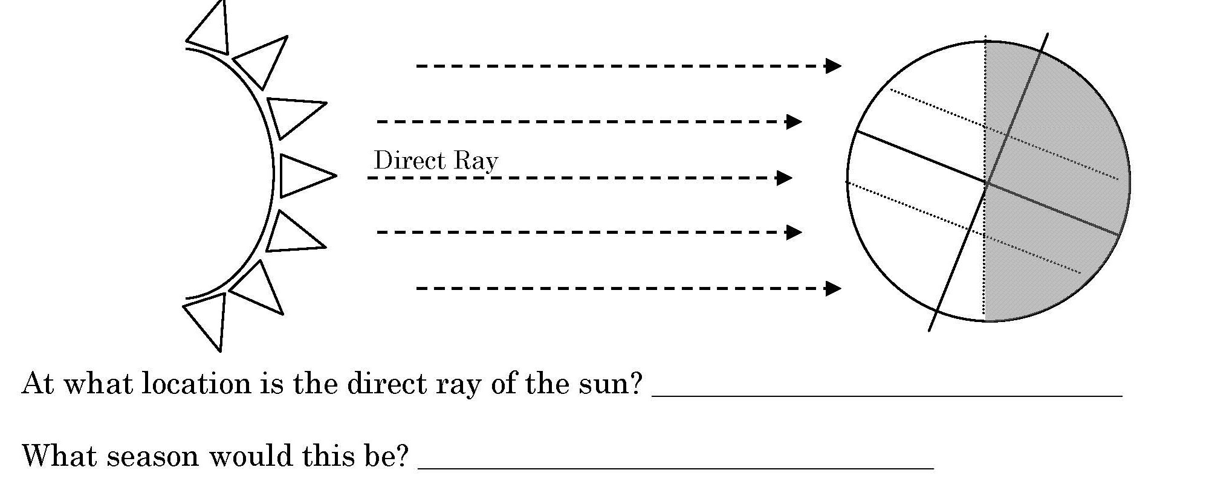
Angle of Insolation/ Angle of Incidence
Tropic of Capricorn
Winter

Slide 36
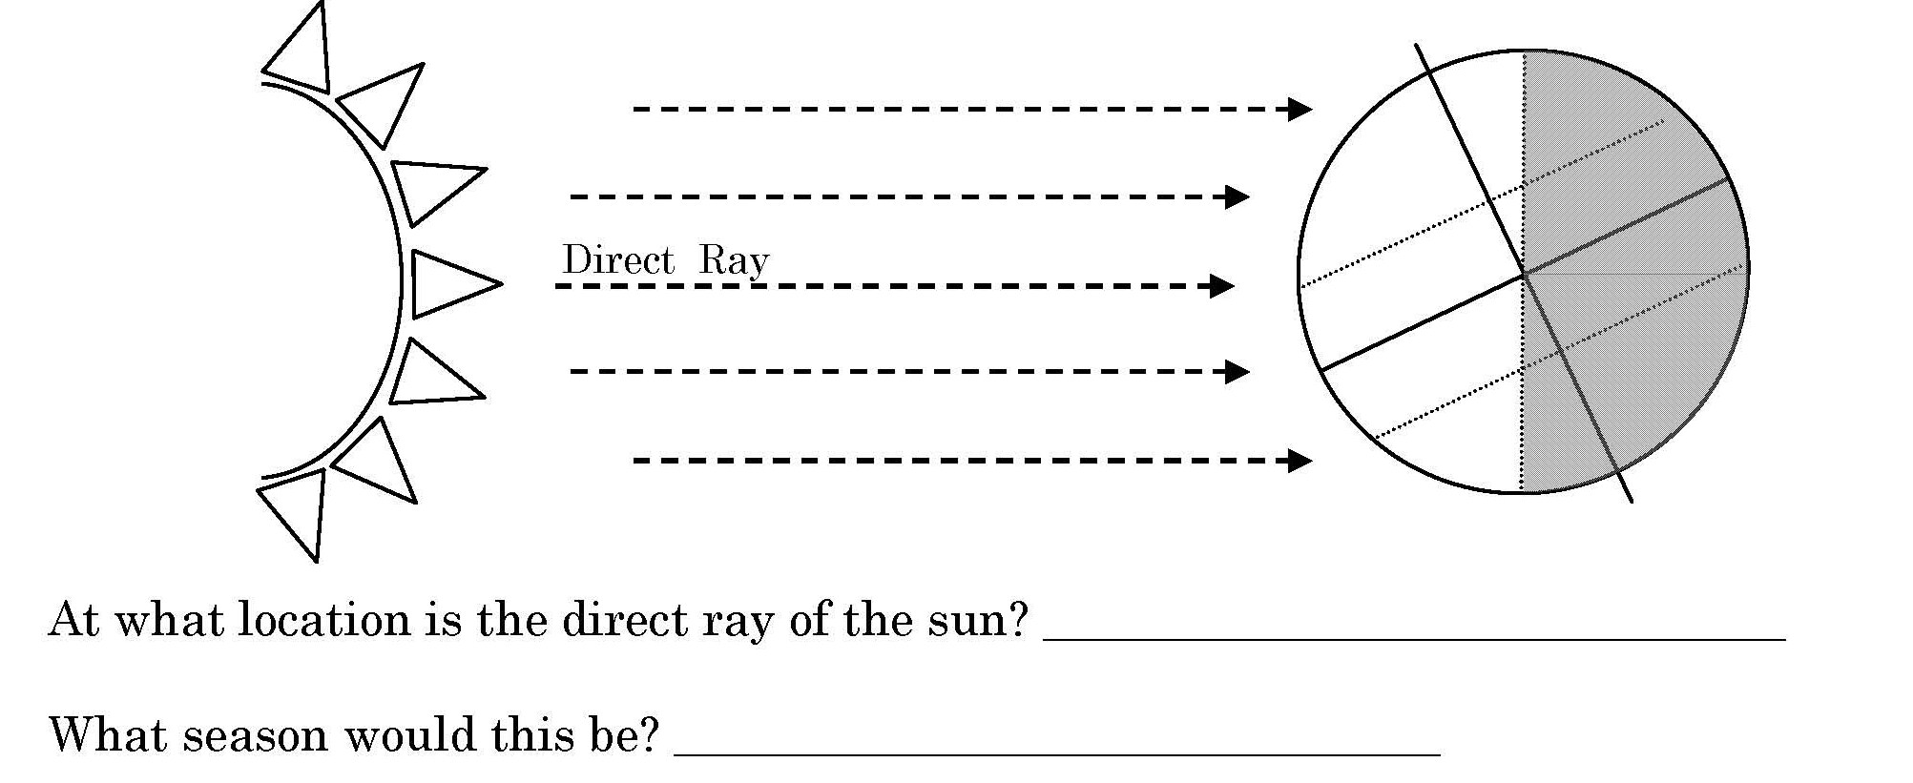
Angle of Insolation/ Angle of Incidence
Tropic of Cancer
Summer

Slide 37
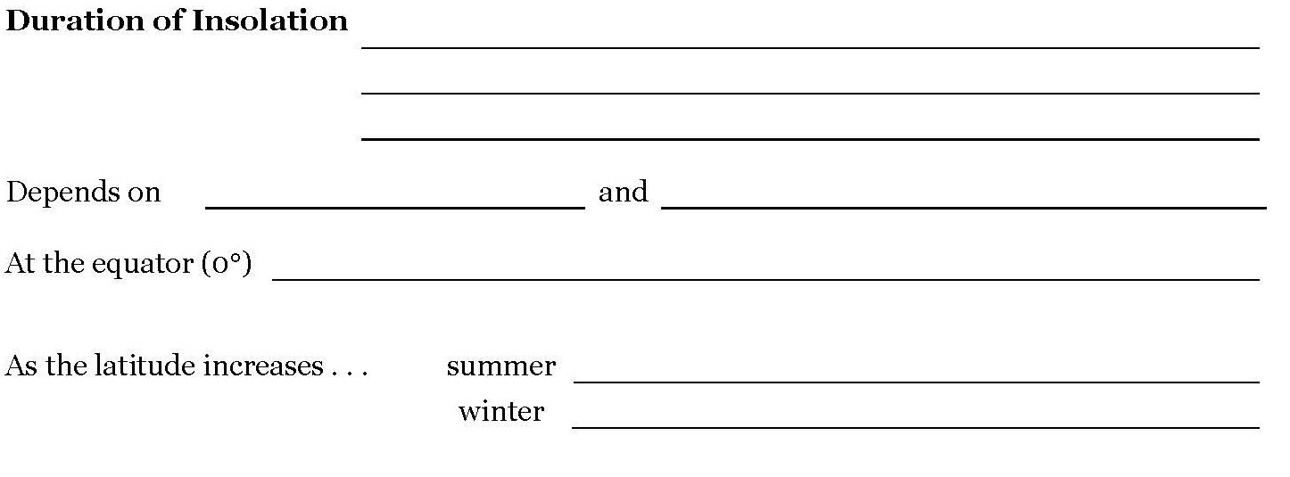
Number of hours of sunlight.
Latitude
Time of Year (season)
12 hours of daylight everyday, no seasons
Longer daylight = warmer temps.
Shorter daylight = cooler temps.

Slide 38
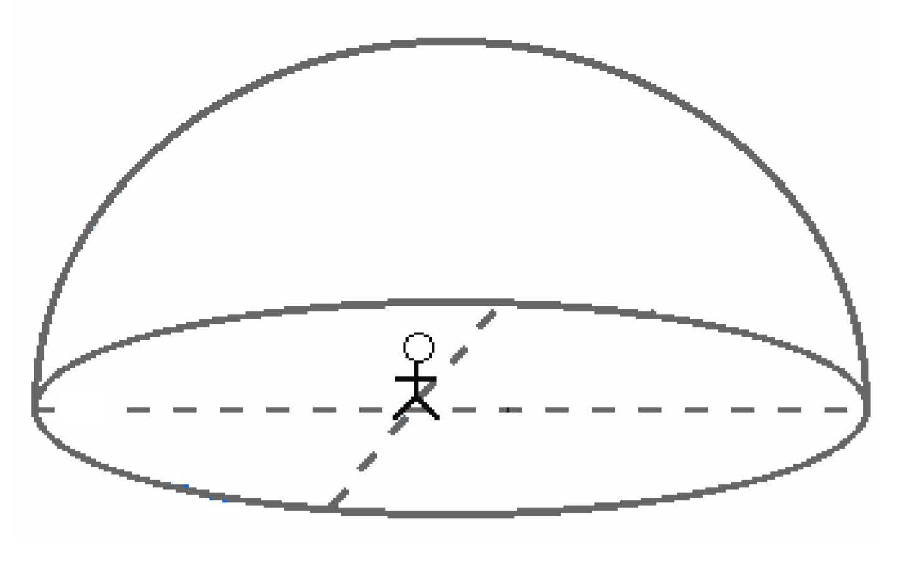
Draw the path of the Sun across the sky for each of the dates of the equinoxes and solstices for NY State.
16hrs
12 hrs
Polaris
8hrs
6pm
40°
6am

Slide 39
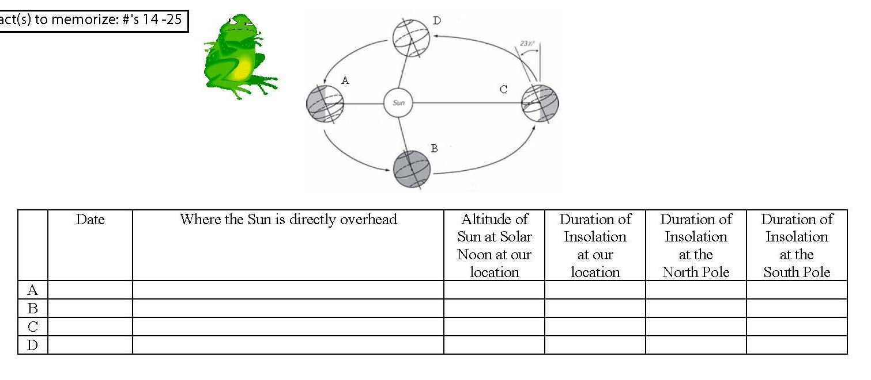

Slide 41
July 4th Sunset in NY…..which direction are you looking?

Slide 42
THE END

Slide 43
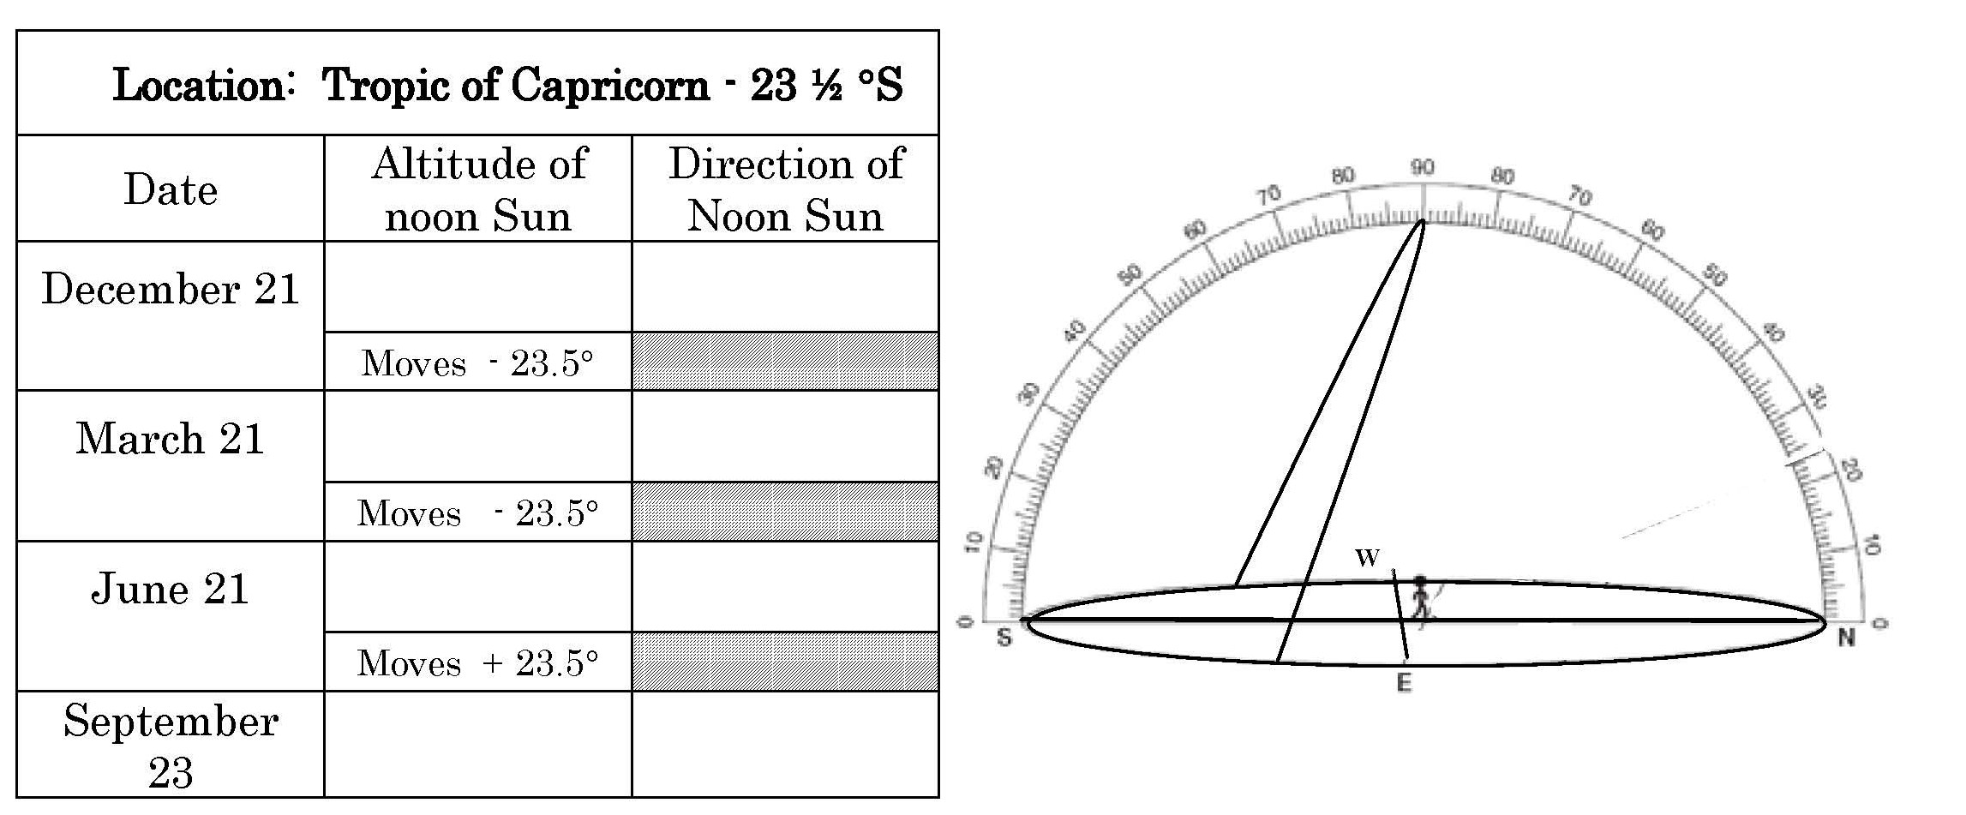

Slide 44
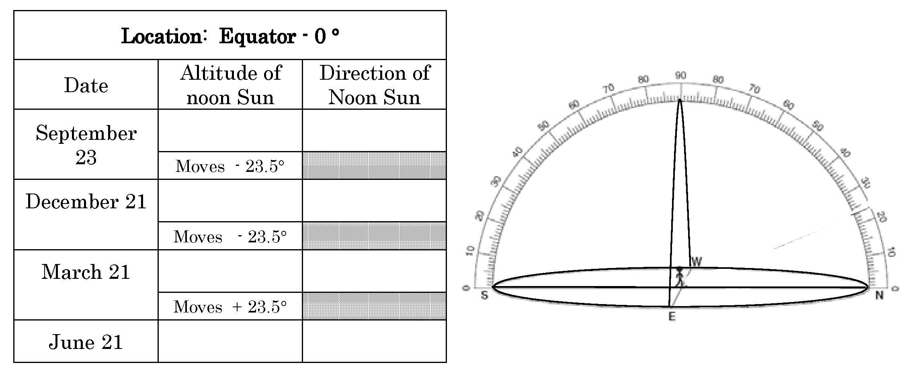

Slide 45
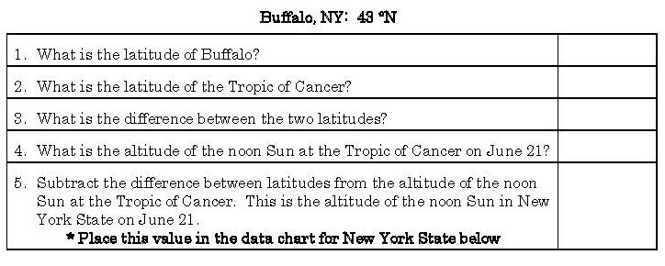
In the N. hemisphere use the Equinoxes as a starting point. The sun is overhead at the equator. So, at 1 degree it is 89 degrees….at 2 degrees it is 88 degrees. At 43 degrees it is 90-43= 47degrees.
43°
23.5
19.5
90
90-19.5=
70.5

Slide 46
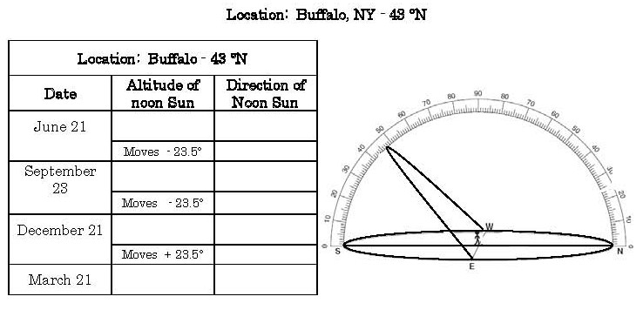
70.5
South
90-43 = 47
South
47-23.5= 23.5
South
90-43 = 47
South

Slide 47
Angle of Insolation Depends on 3 things
Time of Day
Lowest angle of Insolation = cooler
Highest angle of Insolation = warmer
Lowest angle of Insolation = cooler

Slide 48
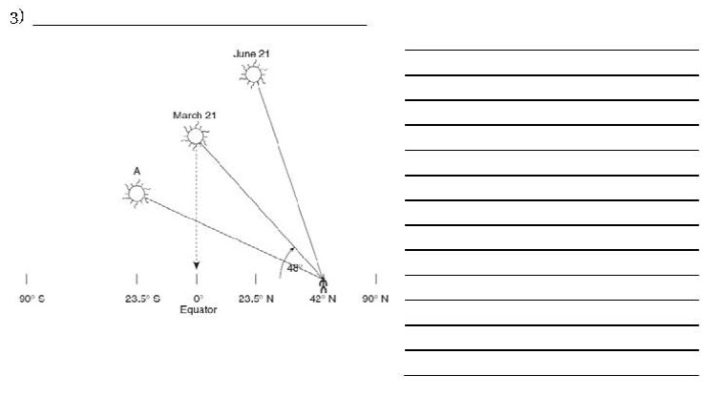
Time of Year
- Summer = sun is highest in the sky = greatest angle of insolation.
http://astro.unl.edu/naap/motion3/animations/sunmotions.swf

Slide 49
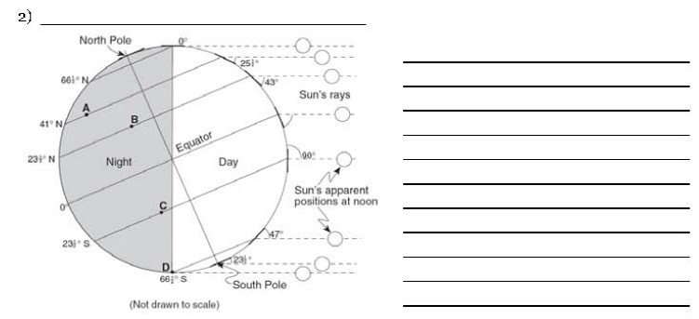
Latitude
- At the equator =more direct rays of sunlight = higher angle of incidence.

Slide 50
